Slide 1
UNALIENABLE RIGHTS
Patriot Week lesson: 6th, 7th, and 8th grade

Slide 2
Launch: Do some people have a greater value than others? Consider how the president is protected by a team of people. What about our military?
Think-Pair-Share: turn to the person next to you and discuss whether you agree or disagree with the statement listed above.

Slide 3
BIG IDEA: EVERY U.S. CITIZEN IS BORN WITH RIGHTS THAT CANNOT BE TAKEN AWAY.

Slide 4
LEARNING OBJECTIVE:
STUDENTS WILL BE ABLE TO DEFINE UNALIENABLE RIGHTS AND UNDERSTAND THE SIGNIFICANCE OF THESE RIGHTS.
STUDENTS WILL BE ABLE TO IDENTIFY WHERE THE CONCEPT OF UNALIENABLE RIGHTS DERIVES FROM.
STUDENTS WILL BE ABLE TO CONNECT THE DECLARATION OF INDEPENDENCE TO UNALIENABLE RIGHTS.
STUDENTS WILL BE ABLE TO UNDERSTAND THOMAS JEFFERSON’S INFLUENCE ON UNALIENABLE RIGHTS.

Slide 5
KEY SKILLS
Unalienable Rights
Declaration of Independence
Thomas Jefferson
The Bill of Rights

Slide 6
What are Unalienable Rights?
Unalienable Rights: Rights that cannot be revoked under any circumstance.
These rights are first mentioned in the Declaration of Independence.
These rights mean that all men are born equal.
Not all types of government recognize that its’ constituents are born with certain rights.
Dictatorships and Monarchies do not recognize these rights.

Slide 7
The Declaration of Independence
Written in June 1776
Thomas Jefferson was the principal author
Jefferson was influenced by the natural rights illustrated in the Social Compact.
This document outlined the fundamental values of the American Revolution.

Slide 8
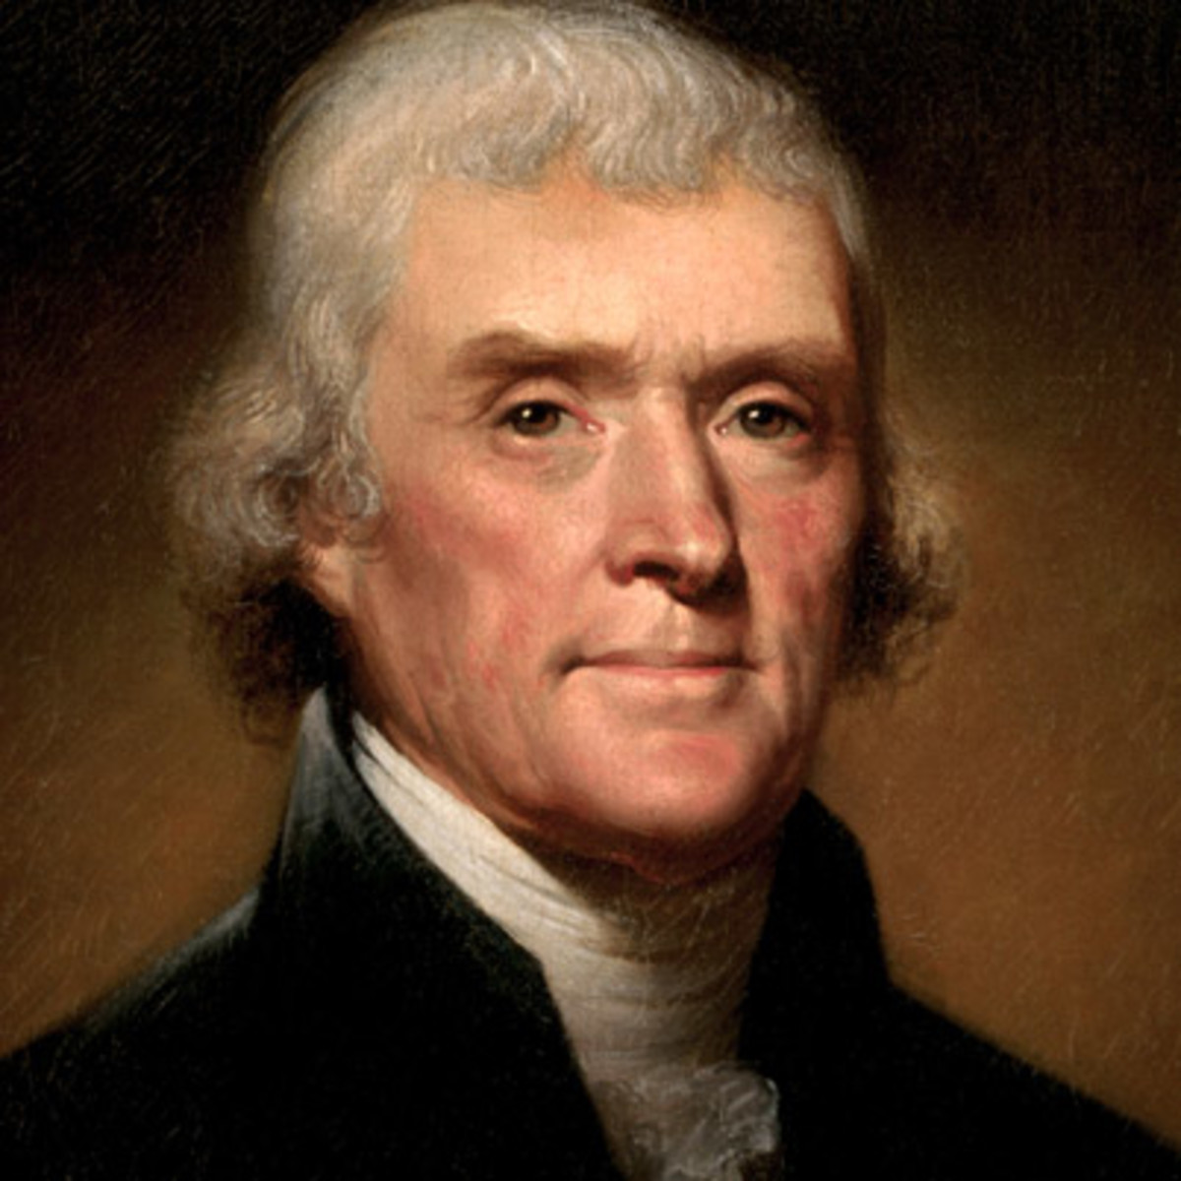
Who was Thomas Jefferson?
Thomas Jefferson (1741-1826)
Founding Father
Main author of the Declaration of Independence.
Third President of the United States
Jefferson opposed a strong central government

Slide 9
The Bill of Rights
The first ten amendments to the Constitution make up the Bill of Rights.
These amendments were created to outline and protect individual rights.
Ten amendments were approved in 1791.

Slide 10
The Bill of Rights
Free exercise of religion
Freedom of speech
Freedom of the press
Right to petition the government
Right to assemble
Right to bear arms
Right to a jury
Right to due process

Slide 11
Bill of Rights
THINK-PAIR-SHARE: How can individual rights come into conflict with the rights of others? Consider our Freedom of Speech.

